Slide 1

AsterixDB Senior Project Final Presentation
Caleb Herbel
Notes:
Hello, and thank you for coming. For those of you that don't know my my name is Caleb, and I'll be showing you a little bit about what i've been working on for the past three quarters. My project was working on interval joins in asterix database.

Slide 2
Background
Asterix is an open-source database
Managed by the Apache Foundation
Highly Scalable NoSQL database
Funded partly by the National Science Foundation
Used by Couchbase, Yardi Systems and more

Slide 3
Asterix Structure
Language: Java
Structured with Maven
Full suite of tests
IntelliJ: IDE
Notes:
runtime query execution engine

Slide 4
Project Goals
Allen’s Relations for Interval Sort Merge Join
Interval Time Sweep Join
Unit Test for Time Sweep’s Active Manager (Added)
Add a query hint to choose between interval joins (Stretch)

Slide 5
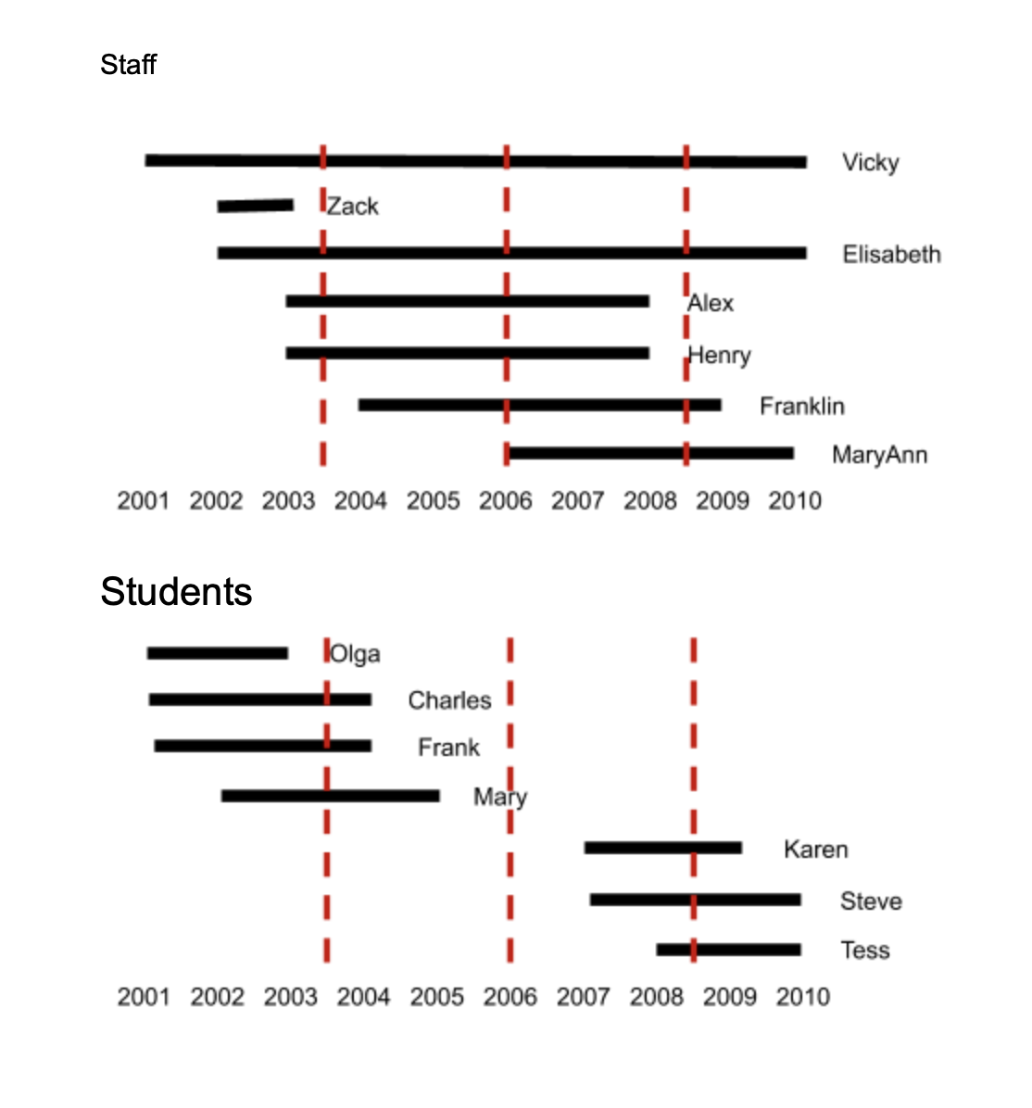
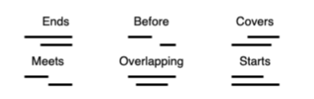
Intervals and Allen’s Relations Goal #1
Photo Created by Dr. Carman

Slide 6
Allen’s Relations
Before
After
Overlaps
Overlapped-by
Overlapping
Covers
Covered-by
Meets
Met-by
Starts
Started-by
Ends
Ended-by
Notes:
Here is the full list of interval relations. The relations in read are the relations that I wanted to implement for my project. I worked on Asterix for Google Summer of Code last year, and I had finished the first 7, so for this project I wanted to complete that task. I had also set up runtime tests that covered these joins, and so the primary goal here was just to implement different functions like the join comparators and methods specific to sort merge join which include methods for memory managment.

Slide 7
Interval Time Sweep Join Goal #2
Asterix Join Utils
Physical Operator
Operator Descriptor
Time Sweep Join Algorithm
Memory Management and other Utilities

Slide 8
Time Sweep’s Algorithm
Write all intervals in probe side to a probe run file, and all intervals on build side to a build run file.
Load tuples from both the probe and build sides into a cursor.
If both have tuples begin the join.
If no more tuples exist on the probe side, process the build side or vice versa. If both sides have tuples process the side with the interval that starts earlier in time.
If the probe side is chosen to be processed first, add the probe tuple to the active sweep manager and then match the probe tuple with all tuples in memory on the build side. If the build side is chosen, do the same thing, but for the build side instead.
Increment whatever side was just processed, and if at least one side still has a tuple go back to step three. Otherwise, close join and print results.

Slide 9
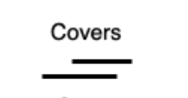
Time Sweep's Algorithm
Build Stream
Probe Stream
Build Memory
Probe Memory
1
3
2
4
2
5
4
5
Results
Build Start <= Probe Start and Build End >= Probe End

Slide 10
Time Sweep's Algorithm
Build Stream
Probe Stream
Build Memory
Probe Memory
1
3
2
4
2
5
4
5
Results
Build Start <= Probe Start and Build End >= Probe End

Slide 11
Time Sweep's Algorithm
Build Stream
Probe Stream
Build Memory
Probe Memory
1
3
2
4
1
3
2
5
4
5
Results
Build Start <= Probe Start and Build End >= Probe End

Slide 12
Time Sweep's Algorithm
Build Stream
Probe Stream
Build Memory
Probe Memory
1
3
2
4
1
3
3
5
4
5
Results
Build Start <= Probe Start and Build End >= Probe End

Slide 13
Time Sweep's Algorithm
Build Stream
Probe Stream
Build Memory
Probe Memory
1
3
2
4
1
3
2
4
3
5
4
5
Results
Build Start <= Probe Start and Build End >= Probe End

Slide 14
Time Sweep's Algorithm
Build Stream
Probe Stream
Build Memory
Probe Memory
1
3
2
4
1
3
2
4
3
5
4
5
Results
1
3
2
4
Build Start <= Probe Start and Build End >= Probe End

Slide 15
Time Sweep's Algorithm
Build Stream
Probe Stream
Build Memory
Probe Memory
1
3
2
4
1
3
2
4
3
5
4
5
Results
1
3
2
4
Build Start <= Probe Start and Build End >= Probe End

Slide 16
Time Sweep's Algorithm
Build Stream
Probe Stream
Build Memory
Probe Memory
1
3
2
4
1
3
2
4
3
5
4
5
3
5
Results
1
3
2
4
Build Start <= Probe Start and Build End >= Probe End

Slide 17
Time Sweep's Algorithm
Build Stream
Probe Stream
Build Memory
Probe Memory
1
3
2
4
1
3
2
4
3
5
4
5
3
5
Results
1
3
2
4
Build Start <= Probe Start and Build End >= Probe End

Slide 18
Time Sweep's Algorithm
Build Stream
Probe Stream
Build Memory
Probe Memory
1
3
2
4
1
3
2
4
3
5
4
5
3
5
4
5
Results
1
3
2
4
Build Start <= Probe Start and Build End >= Probe End

Slide 19
Time Sweep's Algorithm
Build Stream
Probe Stream
Build Memory
Probe Memory
1
3
2
4
1
3
2
4
3
5
4
5
3
5
4
5
Results
1
3
2
4
1
3
4
5
Build Start <= Probe Start and Build End >= Probe End

Slide 20
Time Sweep's Algorithm
Build Stream
Probe Stream
Build Memory
Probe Memory
1
3
2
4
1
3
2
4
3
5
4
5
3
5
4
5
Results
1
3
2
4
3
5
4
5
1
3
4
5
Build Start <= Probe Start and Build End >= Probe End

Slide 21
Time Sweep's Algorithm
Build Stream
Probe Stream
Build Memory
Probe Memory
1
3
2
4
1
3
2
4
3
5
4
5
3
5
4
5
Results
1
3
2
4
3
5
4
5
1
3
4
5
Build Start <= Probe Start and Build End >= Probe End

Slide 22
Time Sweep’s Algorithm spilling
Check which side has most tuples.
Save the position of the stream on the side with less tuples.
Match the stream side, the side with less tuples in memory, with all the tuples in memory on the other side.
Increment the position of the stream side.
Go back to step three until there are no more tuples in the stream.
Finally, flush all tuples from memory on the side we just matched with.
Reset to the position of the stream to the place we saved in step two.
Add the original tuple we tried to add earlier but had to spill instead.
Join the original side with all tuples in memory on the other side.
Continue normal operation of the join.

Slide 23
Active Sweep Manager Test Added Goal
Create Intervals
Serialize Intervals
Create Buffer
Iterate over buffer to add intervals to Active Sweep Manager
Testing whether intervals are added and removed correclty
Checking for correct top point

Slide 24
Project Goals Revisited
Allen’s Relations for Interval Sort Merge Join
Interval Time Sweep Join
Unit Test for Time Sweep’s Active Manager (Added)
Add a query hint to choose between interval joins (Stretch)

Slide 25

Community Results and Engagement

Slide 26
Conclusion
Notes:
Over the course of this quarter I've logged almost 150 hours in AsterixDB. Some of those hours were frustrating, some of those hours were exciting, and In the end it felt great to see Interval Time Sweep working in AsterixDB. Every day I feel like I'm getting more confindent in Asterix DB and I'm excited to continue some the work that I've done in this quarter in my senior project through Google Summer of Code.

Slide 27

Questions

