Slide 1

Goldstream App
By: Jason Riggs

Slide 2
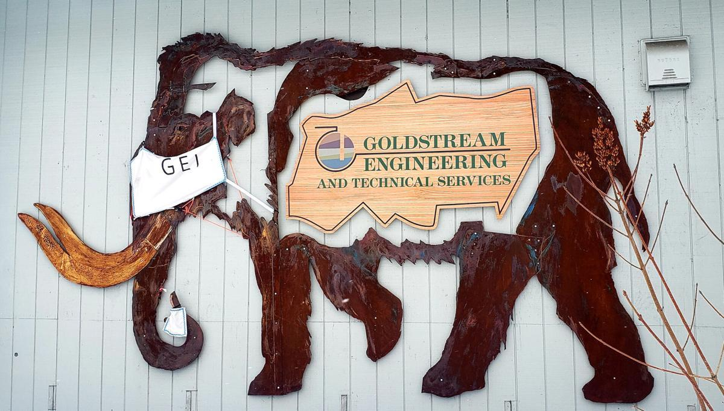
Goldstream Engineering Inc.
Started in 1983 in Fairbanks, AK
Civil, Environmental, and Structural services
From building a bridge in Nenana
To making sure septic systems are up to code

Slide 3
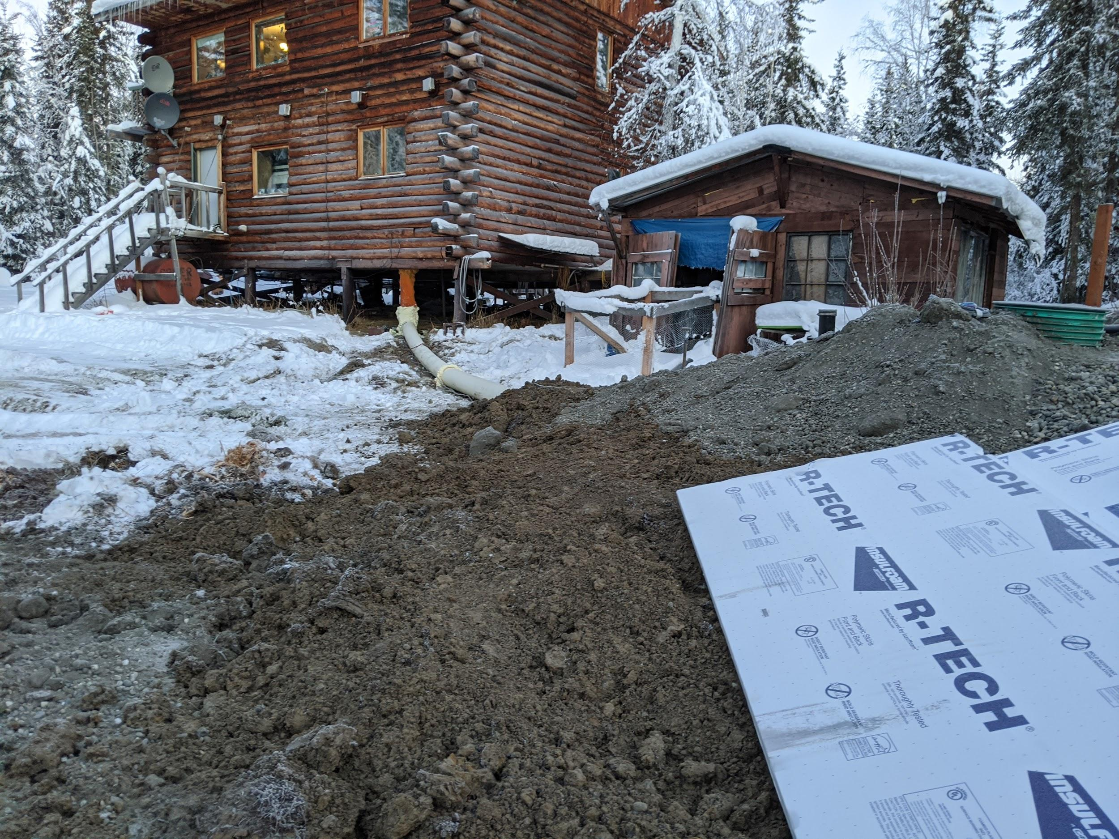
Site visits
The part of their process that the app will be used
Goes to the construction site
Verifies that the construction is going as designed and on schedule
Records the information about the visit and conditions of the site

Slide 4
Objectives
Needs to be able to work offline
Needs to contain all necessary information to record the site conditions
Needs to be converted into a file format that can be downloaded and saved for future reference

Slide 5
Service Worker
A Background programmable proxy that allows the controlling of what happens on a request-by-request basis.
Fetches all necessary information concerning navigation and local app functions
Caches it separate from the browser and network

Slide 6
Local Storage
When input is changed, the handleChange function sets the state of the inputs
Everytime the react React Lifecycle is updated the app checks to see if there is a value set or not
Input value is set to this.state.nameOfVariable

Slide 7
Blob Object
A blob is a file-like object containing raw immutable data
It is not in native javascript form
It gets created into a url and downloads as a .txt file

Slide 8
Demo

Slide 9
Areas for Improvement
Clean up css
Input error checking for better accuracy
List of created files
Auto input date, time, location

Slide 10
What I learned
Working and communicating with a client
A lot more about React
How complex the node_modules and all of its dependencies can get
How far I have come since freshman year

Slide 11
Summary
Goldstream Engineering Inc.
Met all three design criteria
A useful note taking app for them
Learned a lot about development and the process of creating software

