Slide 1

Patient Rewards App
For Oasis Physical Therapy

Slide 2
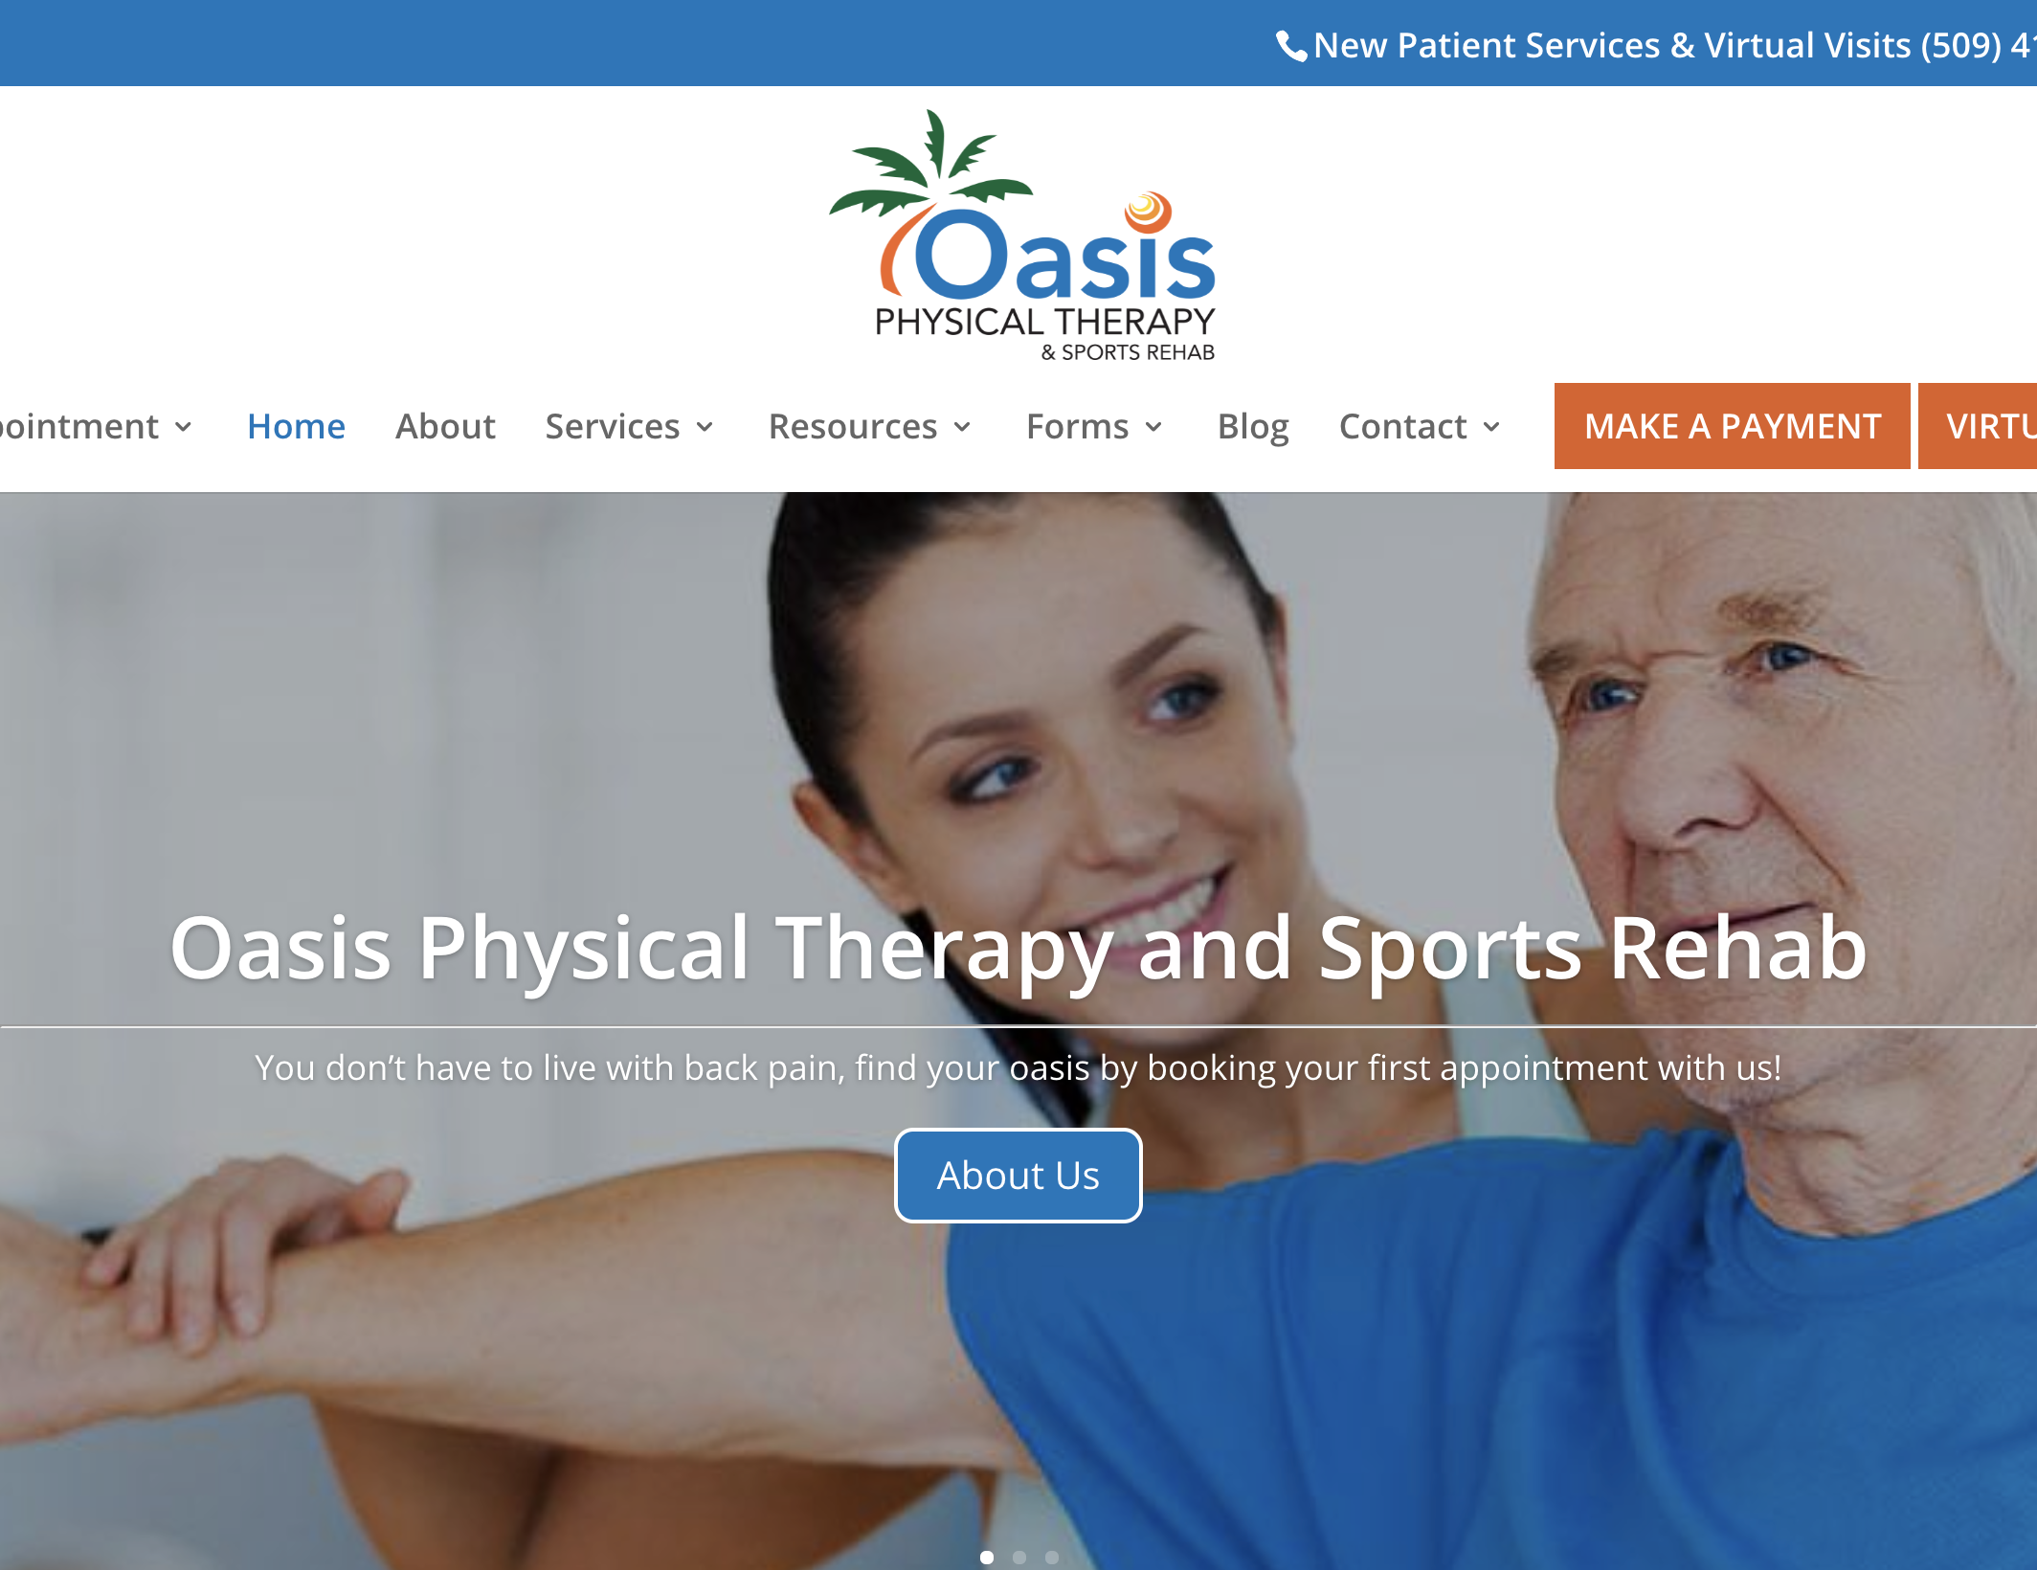
BackGround
Oasis Physical Therapy is a chain of clinics with 4 branches in Tri Cities and one branch here in Walla Walla.
OPT leads the country in patient retention at an average of 60% plan of care but wants to increase that number to 75%.
Average for the nation is ~50%

Slide 3
Project goals
Mobile Web App
Allow patient to see available tasks and rewards with associated point values.
Patient can scan therapist’s QR code to verify task completion.
Admin Web Portal
Admin users can edit the list of rewards and tasks
Admins can see the database of patients and run stat reports based on different filters and queries.
Professionality
Should have a clean, familiar UI and be devoid of bugs to uphold OPT’s fine reputation for quality of care.

Slide 4
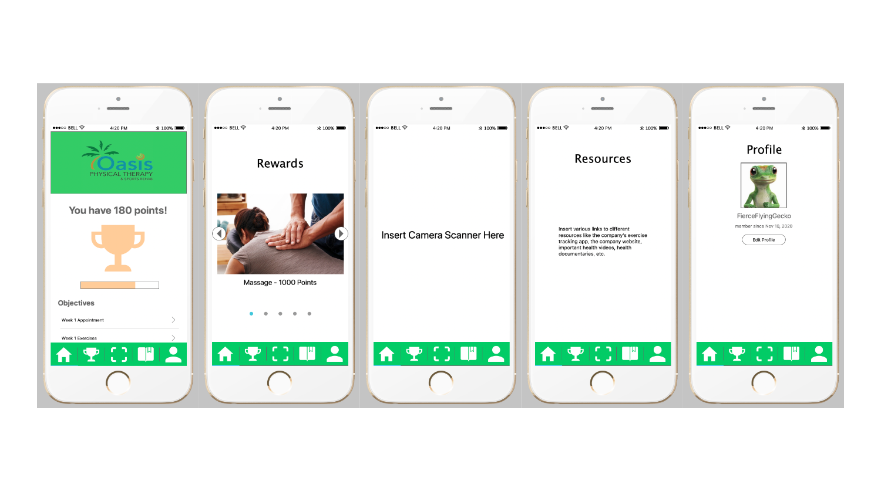
Patient Mobile Mock UI design

Slide 5
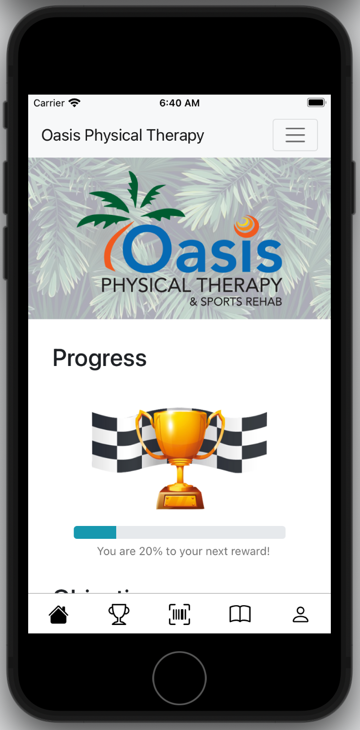
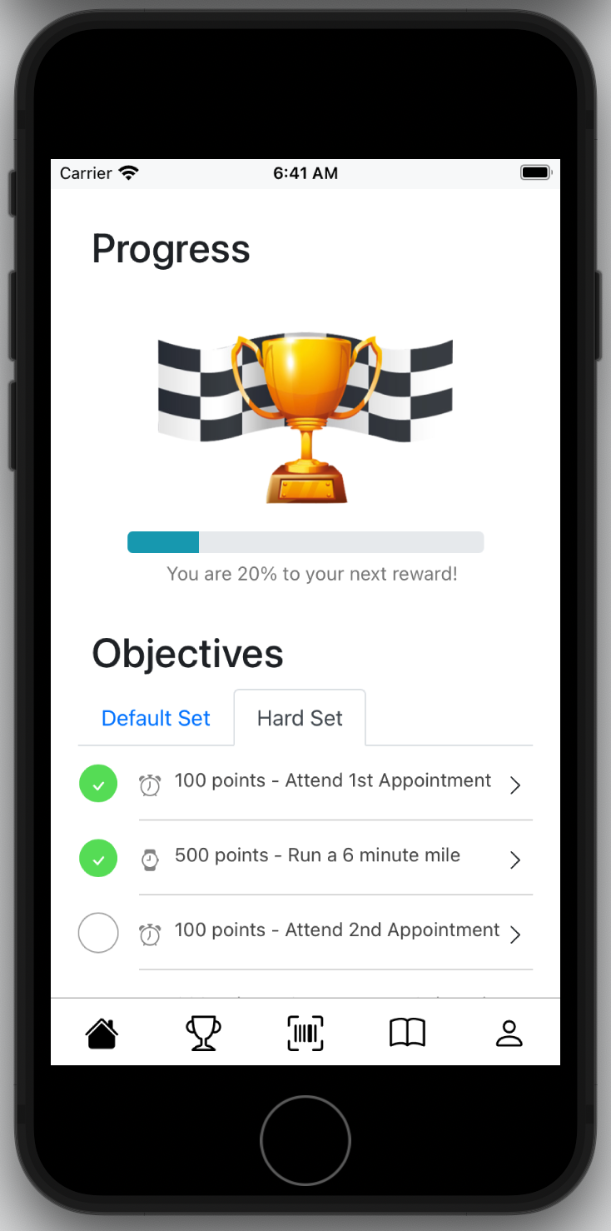
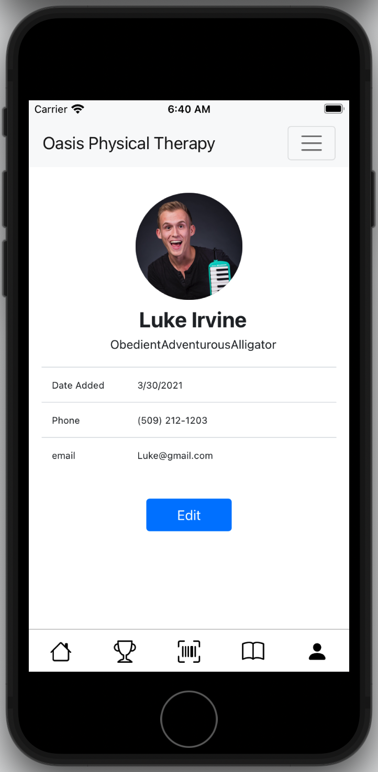
Patient Mobile Implemented UI design

Slide 6
Review of tools
Mobile User Interface
React.JS via Apache Cordova
Security
Firebase Authentication
Hardware
Firebase Hosting
Database
Firebase Realtime Database

Slide 7
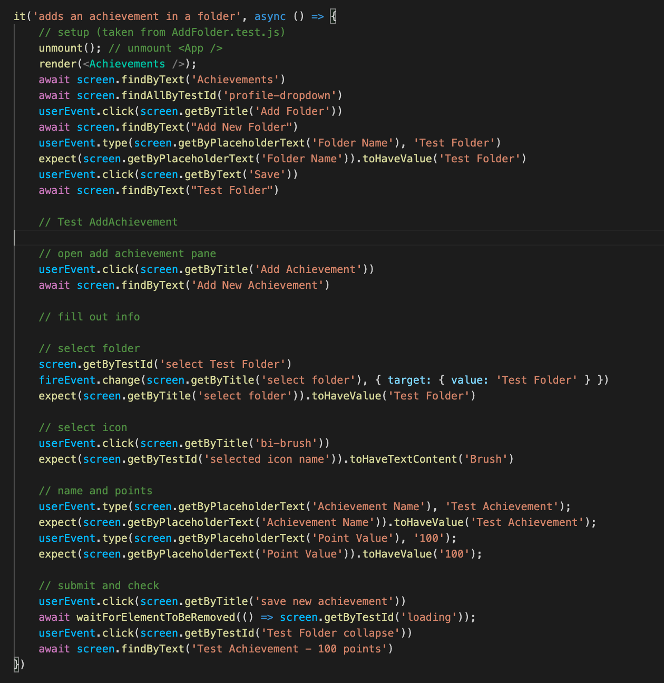
Testing
Firebase Emulator
Jest Testing Framework
React Testing Library
CI with GitHub Actions

Slide 8
Perceived Challenges from fall quarter
Learning how to set up a Client/Server app on a cloud-hosting server
01
Learning how to work with a database when multiple clients can be accessing and modifying data at once.
02
Encouraging patients of all ages to use a mobile web app. It’s less convenient than a native app. May look in to providing iOS/Android home screen shortcut.
03

